Slide 1

Transformer-Based Emotion Recognition Using Multimodal Data Fusion
Submitted By:
Shivendu Mishra (206124031)
Guide:
Dr. R. Bala Krishnan
DEPARTMENT OF COMPUTER SCIENCE AND ENGINEERING
NATIONAL INSTITUTE OF TECHNOLOGY, TIRUCHIRAPPALLI
206124031
CS677 : Transformer-Based Emotion Recognition Using Multimodal Data Fusion

Slide 2
1. PROBLEM STATEMENT, OBJECTIVES, & MOTIVATION
Problem Statement
  To develop a robust multimodal emotion recognition system using Transformer-based architecture
  Effectively models the cross-modal dependencies and temporal dynamics across the physiological signals
Objectives
  To design a Transformer-based multimodal system
  To fuse the ECG, EDA, and acceleration features to predict the emotions
  To reduce the artifacts in the signals
  To improve the accuracy
Motivation
  To enhance the human-computer interaction
  To bridge the gap between the laboratory validations and real-world deployment
  To support affective computing
206124031
CS677 : Transformer-Based Emotion Recognition Using Multimodal Data Fusion

Slide 3
2-A. LITERATURE SURVEY
Sl. No. | Paper Details | Techniques Used | Gaps Identified
1. | Title: UAED: Unsupervised Abnormal Emotion Detection Network Based on Wearable Mobile Device Author: J. Zhu et al. Year: 2023 | Gaussian Mixture VAE 2D-CNN with stacking Whitening distance anomaly scoring Unsupervised training | Unimodal approach – Uses only ECG signals No cross-modal attention – Cannot leverage multiple physiological signals Limited emotion granularity – Only binary anomaly detection Fixed window processing – No adaptive temporal modeling
2. | Title: Self-supervised ECG Representation Learning for Emotion Recognition Author: P. Sarkar et al. Year: 2022 | Self-supervised learning Contrastive pre-training CNN-LSTM architecture Transfer learning fine-tuning | Single modality dependency – ECG-only approach No multimodal fusion – Misses complementary signal information Supervised requirement – Needs labeled data for fine-tuning Short-term focus – Limited long-range temporal context
206124031
CS677 : Transformer-Based Emotion Recognition Using Multimodal Data Fusion

Slide 4
2-B. LITERATURE SURVEY CONTD.
Sl. No. | Paper Details | Techniques Used | Gaps Identified
3. | Title: Behavioral and Physiological Signals-Based Deep Multimodal Approach for Mobile Emotion Recognition Author: K. Yang et al. Year: 2023 | LSTM with attention Multimodal fusion Mobile deployment optimization Behavioral + physiological signals | Limited temporal context – LSTM struggles with long sequences Sequential processing – Inherent RNN limitations Shallow fusion – Basic attention on temporal dimension only Limited physiological coverage – Focuses more on behavioral sensors
4. | Title: EmotionSense: An Adaptive Emotion Recognition System Author: Z. Wang et al. Year: 2020 | Random Forest classifiers Wearable sensor integration Context-aware recognition Personalization approach | Shallow models – Limited feature learning capacity Traditional ML limitations – Poor scalability with complex data Feature engineering dependency – Manual feature extraction required No deep temporal modeling – Cannot capture the complex temporal patterns
206124031
CS677 : Transformer-Based Emotion Recognition Using Multimodal Data Fusion

Slide 5
2-C. LITERATURE SURVEY CONTD.
Sl. No. | Paper Details | Techniques Used | Gaps Identified
5. | Title: Attention Is All You Need Author: A. Vaswani et al. Year: 2017 | Transformer Architecture Scaled Dot-Product Attention Multi-Head Attention Positional Encoding Encoder-Decoder Structure | High Computational Complexity (O(n²) with sequence length) No Native Multimodal Support – Designed for NLP Large Data Requirements for effective training No Domain Adaptation for physiological signals
206124031
CS677 : Transformer-Based Emotion Recognition Using Multimodal Data Fusion

Slide 6
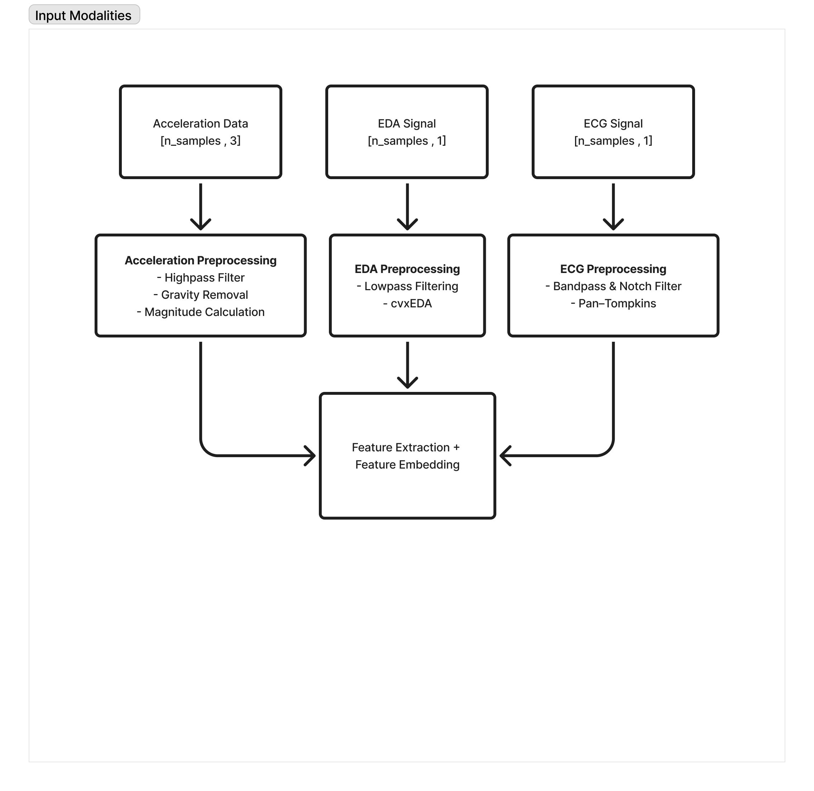
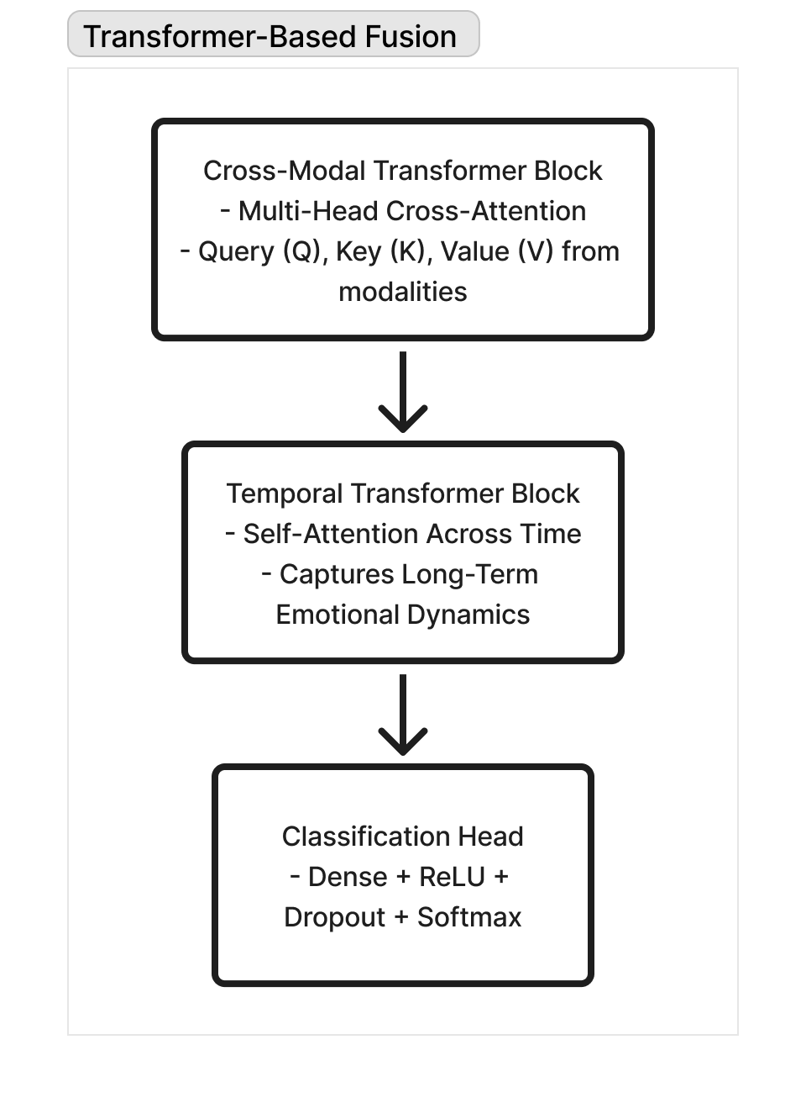
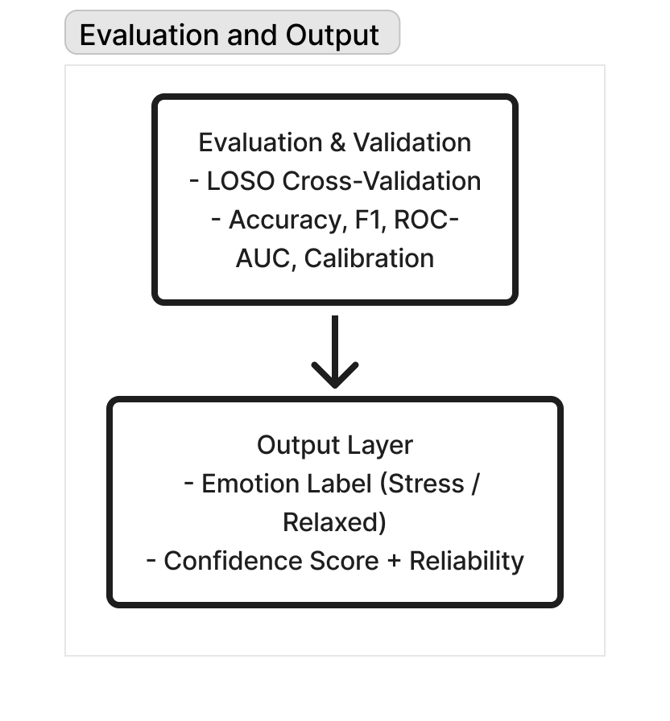
3-A. BLOCK SCHEMATIC
206124031
CS677 : Transformer-Based Emotion Recognition Using Multimodal Data Fusion

Slide 7
4-A. ALGORITHMS
ALGORITHM: Pan-Tompkins + Heart Rate Variability (HRV) Feature Extraction
INPUT
  Raw ECG signal x(t) sampled at 700 Hz
PROCESS
  Step 1: Apply a bandpass filter to remove the baseline wander and high-frequency noise
  Step 2: Use the Pan-Tompkins algorithm to detect R-peaks
    Differentiate → Square → Moving window integration → Threshold
    Output is a list of detected R-peak indices
  Step 3: Compute R–R intervals to estimate beat-to-beat timing
  Step 4: Derive Heart Rate Variability (HRV) features, such as mean RR, SDNN, RMSSD, etc.
OUTPUT
  Clean ECG signal with noise removed
206124031
CS677 : Transformer-Based Emotion Recognition Using Multimodal Data Fusion

Slide 8
4-B. ALGORITHMS CONT.
ALGORITHM: Convex Optimization (cvxEDA Decomposition)
INPUT
  Raw EDA signal 𝑦(𝑡)y(t) collected from wrist sensor
PROCESS
  Step 1: Apply a low-pass filter (cutoff = 2 Hz) to remove high-frequency fluctuations
  Step 2: Use cvxEDA (Convex Optimization-based Decomposition) to split the signal
    Tonic component (T): Slow baseline skin conductance
    Phasic component (P): Fast changes linked to emotional arousal
  Step 3: Detect Skin Conductance Response (SCR) peaks from the phasic component 𝑟
  Step 4: Extract statistical features — Mean, Standard Deviation, and Number of SCR Peaks
OUTPUT
  Clean ECG signal with noise removed
206124031
CS677 : Transformer-Based Emotion Recognition Using Multimodal Data Fusion

Slide 9
4-C. ALGORITHMS CONT.
ALGORITHM: Convex Optimization (cvxEDA Decomposition)
INPUT
  3-axis acceleration signal 𝑎_{𝑥}(𝑡) , 𝑎_{𝑦}(𝑡) , 𝑎_{𝑧}(𝑡)
PROCESS
  Step 1: Apply a high-pass filter (cutoff = 0.5 Hz) to remove the gravitational components
  Step 2: Compute the magnitude of the resultant acceleration
  Step 3: Segment the signal into small time windows (for example, 4 to 6 s)
  Step 4: Extract the activity-level features such as mean, variance, energy, and entropy
OUTPUT
  Clean ECG signal with noise removed
206124031
CS677 : Transformer-Based Emotion Recognition Using Multimodal Data Fusion

Slide 10
4-D. ALGORITHMS CONTD..
ALGORITHM: Cross-Modal Transformer with Multi-Head Attention (Fusion Stage)
INPUT
  Embedded feature sequences for each modality: 𝑒_{𝐸𝐶𝐺}, 𝑒_{𝐸𝐷𝐴}, 𝑒_{𝐴𝐶𝐶} obtained from CNN encoders or preprocessing
PROCESS
  Step 1: Prepare attention inputs
    For each modality 𝑚, create: Query (Q_{m}) , Key (K_{m}) , Value (V_{m})
  Step 2: Compute attention weights
      Use scaled dot-product attention to decide how strongly one signal should focus on another
  Step 3: Use multiple attention heads
    Several parallel “heads” learn different kinds of relationships
  Step 4: All heads are concatenated and linearly combined
OUTPUT
  Model outputs a single fused vector 𝐹_{𝑓𝑢𝑠𝑖𝑜n}
206124031
CS677 : Transformer-Based Emotion Recognition Using Multimodal Data Fusion

Slide 11
4-E. ALGORITHMS CONTD..
ALGORITHM: Temporal Transformer Block (Sequential Modeling)
INPUT
  Sequence of fused embeddings 𝐹_{𝑓𝑢𝑠𝑖𝑜𝑛,𝑡} obtained from the Cross-Modal Transformer
PROCESS
  Step 1: Add positional information
    Since Transformers don’t know time order naturally, add positional encodings
  Step 2: Compute self-attention across time
    For every time window, compute attention
  Step 3: Residual + Layer Normalization
    Maintains stable gradients and keeps temporal context consistent
  Step 4: A small network refines each time-step’s contextual embedding, strengthening the temporal coherence
OUTPUT
  Final time-dependent emotional embedding 𝐹_{𝑡𝑒𝑚𝑝𝑜𝑟𝑎l}
206124031
CS677 : Transformer-Based Emotion Recognition Using Multimodal Data Fusion

Slide 12
5. EXPERIMENTS & PERFORMANCE METRICS
Experimental Setup
  Dataset: WESAD (primary) and AffectiveROAD (supplementary)
  Training:
    ECG/EDA CNN: 100 epochs × 32 batch size
    Acceleration CNN: 50 epochs × 64 batch size
    Optimizer: AdamW (Weight Decay = 0.01, β₁ = 0.9, β₂ = 0.999, ε = 1e-8)
    Validation: LOSO Cross Validation
Performance Metrics
  Core Metrics: Accuracy, ROC-AUC, PR-AUC
  Calibration Metric: Expected Calibration Error (ECE) – Assesses the reliability of predictions
  Subject-Level Metric: Inter Subject Variability (ISV) – Measures the generalization
Model Setup
  Modality specific CNN encoders for ECG, EDA, and Acceleration
  Cross-Modal Transformer Fusion + Temporal Transformer for sequence modeling
206124031
CS677 : Transformer-Based Emotion Recognition Using Multimodal Data Fusion

Slide 13
6. IMPLEMENTATION ENVIRONMENT
Hardware
  Processor: Intel i7 / AMD Ryzen 7 (8-core, 3.0GHz+)
  RAM: 16 GB minimum
  Storage: 500 GB NVMe SSD
  GPU: NVIDIA RTX 4060 (12 GB VRAM) or equivalent CUDA-enabled GPU
  Operating System: Windows 11 (64-bit)
Software & Libraries
  Language: Python 3.10.x
  IDE: Visual Studio Code
  Core Framework: PyTorch (with CUDA support)
  Deep Learning Models
    NeuroKit2/SciPy Essential for robust ECG R-peak detection, cvxEDA decomposition, and HRV analysis
    Transformers (for implementing attention mechanisms)
  Data Handling & Processing: NumPy, Pandas, OpenCV, Open3D
  Visualization Tools: Matplotlib, TensorBoard, Seaborn
206124031
CS677 : Transformer-Based Emotion Recognition Using Multimodal Data Fusion

Slide 14
7. EXPECTED MILESTONE / WORK PLAN
Milestone | Period | Works to be Completed
MS0 | 14 Aug 2025 – 26 Oct 2025 | Literature survey, tool & language selection, dataset setup (WESAD/AffectiveROAD), sensor level study, bio-signal study, algorithm selection, and project planning
MS1 | 29 Oct 2025 – 23 Nov 2025 | Implement preprocessing for ECG, EDA, and acceleration (filtering, HRV, SCR, activity features) and begin 1D-CNN feature extraction
MS2 | 26 Nov 2025 – 21 Dec 2025 | Integrate feature embeddings and Transformer-based fusion, temporal modeling, and perform preliminary training and validation
MS3 | 24 Dec 2025 – 31 Dec 2025 | Conduct full LOSO evaluation, performance analysis and finalize document
206124031
CS677 : Transformer-Based Emotion Recognition Using Multimodal Data Fusion

Slide 15
8. REFERENCES
[1] J. Zhu, J. Jiang, and X. Zhao, “UAED: Unsupervised Abnormal Emotion Detection Network Based on Wearable Mobile Device,” IEEE Transactions on Affective Computing, vol. PP, no. 99, pp. 1–12, 2023.
[2] K. Yang, X. Huang, and Y. Liu, “Behavioral and Physiological Signals-Based Deep Multimodal Approach for Mobile Emotion Recognition,” IEEE Transactions on Mobile Computing, vol. PP, no. 99, pp. 1–10, 2023.
[3] P. Sarkar, S. Dey, and A. Dutta, “Self-Supervised ECG Representation Learning for Emotion Recognition,” IEEE Sensors Journal, vol. 22, no. 18, pp. 17456–17464, 2022.
[4] Z. Wang, X. Chen, and Y. Zhang, “EmotionSense: An Adaptive Emotion Recognition System,” IEEE Internet of Things Journal, vol. 7, no. 9, pp. 8550–8563, 2020.
[5] D. Pollreisz and N. TaheriNejad, “Detection and Removal of Motion Artifacts in PPG Signals,” Mobile Networks and Applications, vol. 27, pp. 728–738, Aug. 2019.
[6] A. Vaswani, N. Shazeer, N. Parmar, J. Uszkoreit, L. Jones, A. N. Gomez, Ł. Kaiser, and I. Polosukhin, “Attention Is All You Need,” Advances in Neural Information Processing Systems (NeurIPS), pp. 5998–6008, 2017.
[7] A. Greco, G. Valenza, M. Nardelli, M. Bianchi, L. Citi, and E. P. Scilingo, “Force–Velocity Assessment of Caress-Like Stimuli Through the Electrodermal Activity Processing: Advantages of a Convex Optimization Approach,” IEEE Transactions on Human-Machine Systems, vol. 47, no. 1, pp. 91–100, Feb. 2017.
206124031
CS677 : Transformer-Based Emotion Recognition Using Multimodal Data Fusion

Slide 16
THANK YOU

